Slide 1


Gotcha
Almog Hackathon 2021

Slide 2
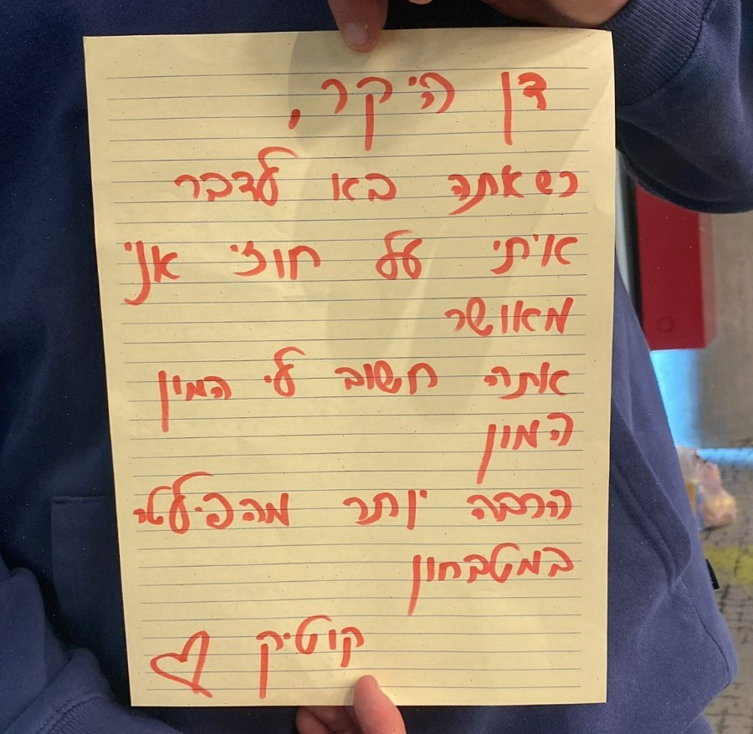
Kotick is a talented poet.

Slide 3



















WHO POSTED THE POEM ONLINE?

Slide 4

Introducing Gotcha.
Find out who leaked your personal data.
Prevent cyberbullying.
Protect organization data.

Slide 5
Demonstration

Slide 6

Thank you!
Matan Kotick
Gal Sade
Noam Fogelnest
Yaron Shinkar
Shavit Borisov
* PICK US
* You know we are the best team

